Slide 1

CPE 490 Embedded Systems
dsPIC 33 Configuration bits
Clock options
More loops for and do

Slide 2
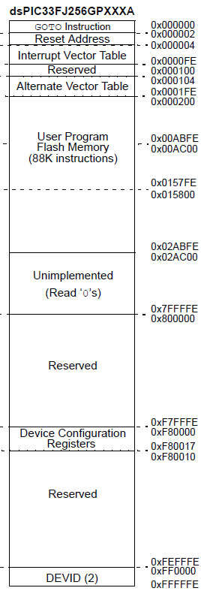
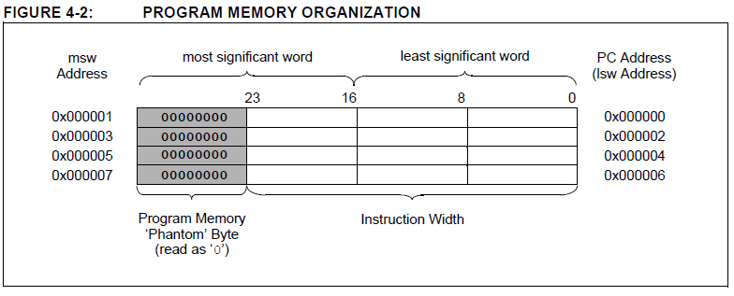
dsPIC33 Program Memory
Notes:
Total of 4 M of addressable instructions are available from the 23 bit PC. (2^23 addresses * instructions /2 addresses) This space ends at 0x7FFFFF
Reset and interrupt vectors are located from 0 to 0x1FE (510 decimal meaning that there are 256 instruction spaces.
Regular program memory is from 0x200 (512) to 0x2ABFE (175,102) or 87296 instruction workds
Configuration memory starts at 0x800000 that is one higher than what is addressable by the 23 bit PC counter in this space only the configuration 0xF80000 to F80016 and Device ID spaces can be found between 0xFF0000 to 0xFFFFFE FFFFE = 65534->(65534/2 = 32K)

Slide 3
Accessing Configuration Memory with Code
Memory can only be accessed with special assembly instructions called table read and write instructions
Address is formed with 16 LS bits in a working register and the 8 most MS bits in SFR TBLPAG
Memory is by default 1 at power up and any bit can be set to 0 once per power up cycle

Slide 4
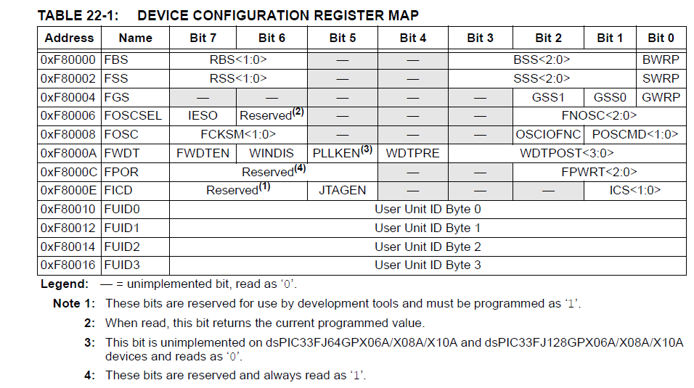
Configuration Bits
Notes:
The Configuration bits can be programmed (read as ‘0’), or left unprogrammed (read as ‘1’), to select various device configurations. These bits are mapped starting at program memory location 0xF80000.
To prevent inadvertent configuration changes during code execution, all programmable Configuration bits are write-once. After a bit is initially programmed during a power cycle, it cannot be written to again. Changing a device configuration requires that power to the device be cycled.

Slide 5
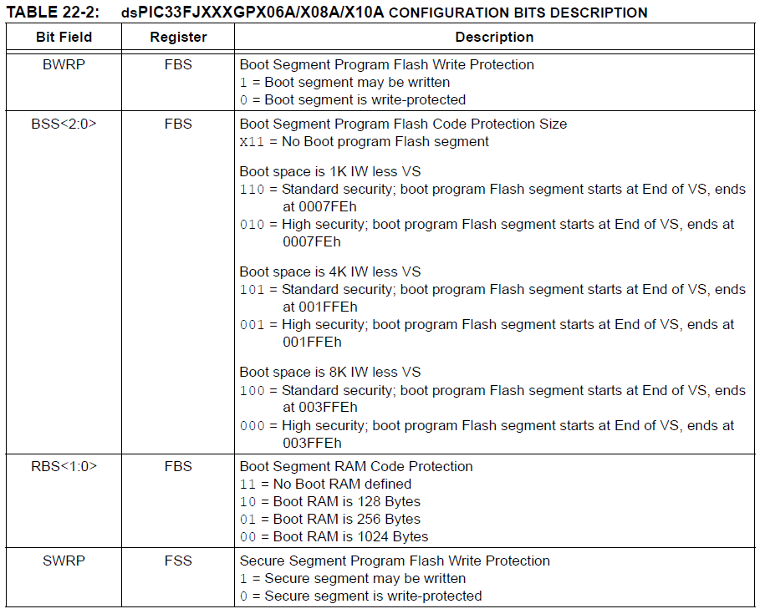
FBS Boot Sector Configuration
Notes:
For our setup we will leave this at all 1s
The boot sector if used can be used to download a program to your embedded system. This can be from some mass storage device. You want to protect the boot loader from being overwritten.

Slide 6
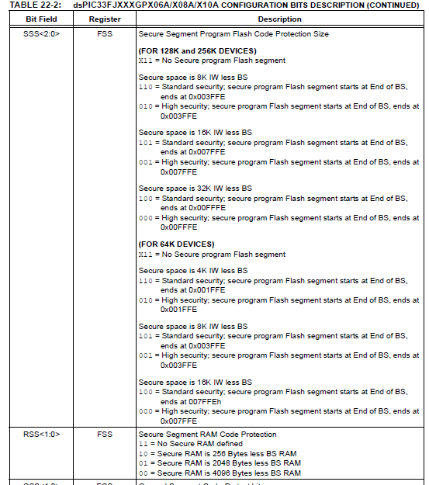
FSS Secure Code Segment
Notes:
Leave at all 1s
This section is used secure code from being read to hide proprietary code from even third party vendors working on code with you.

Slide 7
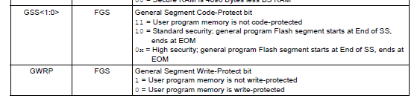
FGS General Segment
Notes:
Leave at all 1s

Slide 8
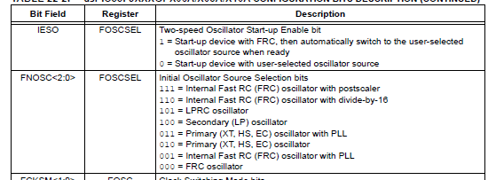
FOSCSEL Oscillator Selection
Notes:
We want start up with FRC or IESO=1, and we want initial oscillator to be Primary (XT, HS, EC) oscillator with PLL, FNOSC = 011 or FOSCSEL = 0xFFFB.
Using the internal RC oscillator will make the code start up fast, although the time base can now change. I believe you could make IESO=0 and be ok just start up slower.

Slide 9
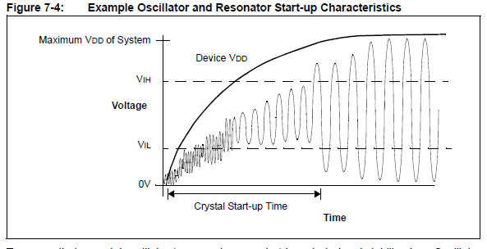
Clock Start UP
Vih = . 7Vdd
Vil = .2 Vdd
Notes:
This illustrates how a crystal oscillator starts up. The Crystal start up time can depend on :
Crystal and resonator frequency
• Capacitor values used (C1 and C2 in Figure 7-3)
• Device VDD rise time
• System temperature
• Series resistor value and type if used
• Oscillator mode selection of device (selects the gain of the internal oscillator inverter)
• Crystal quality
• Oscillator circuit layout
• System noise

Slide 10
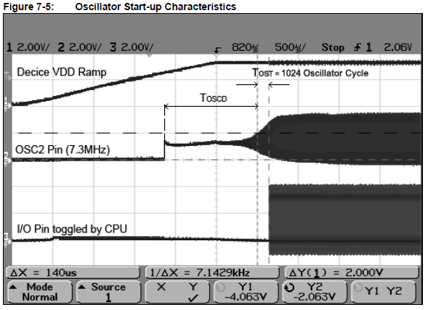
Scope Capture of Osc Startup
Notes:
Tost is always on no way to stop it.

Slide 11
FRC Oscillator Options
The Internal Fast RC (FRC) Oscillator provides a nominal 7.37 MHz clock without requiring an external crystal or ceramic resonator, which results in system cost savings for applications that do not require a precise clock reference.
RC can be tuned with a SFR in range of -12% to +11.625%
Post scale divide 1,2,4,8,16,32,64,256
FRC starts up almost immediately.
Notes:
PLL use possible.

Slide 12
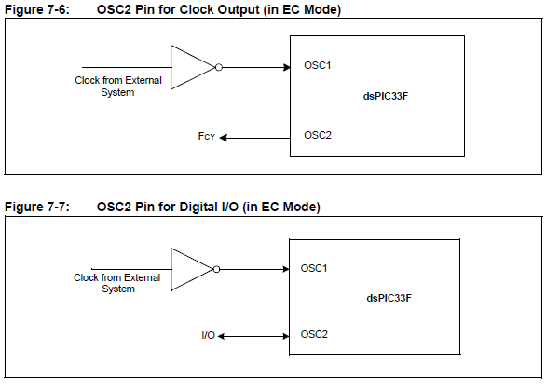
External Clock (EC) option
A separate clock with its own driving circuit external to the dsPic
Can free up an I/O pin

Slide 13
Low Power RC Oscillator
The Low-Power RC (LPRC) oscillator provides a nominal clock frequency of 32 kHz.
The LPRC is the clock source for the Power-up Timer (PWRT), Watchdog Timer (WDT) and Fail-safe Clock Monitor (FSCM) circuits.
It can also be used to provide a low-frequency clock source option for the device in those applications where power consumption is critical and timing accuracy is not required.

Slide 14
Secondary Low Power Oscillator
The Low-Power Secondary Oscillator enables a 32.768 kHz watch crystal to be attached to the dsPIC33F device as a secondary crystal clock source for low-power operation.
It uses the SOSCIand SOSCO pins.
The Low-Power Secondary Oscillator can also drive Timer1 for Real-Time Clock (RTC) applications.

Slide 15
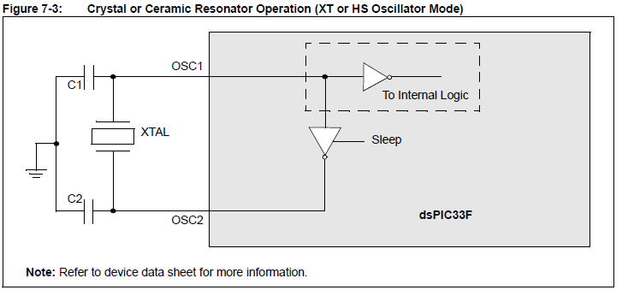
XT and HS Crystal Oscillators
XT: medium gain, medium frequency mode used to work with crystal frequencies of 3 to 10 MHz.
HS: high-gain, high-frequency mode used to work with crystal frequencies of 10 to 40 MHz.

Slide 16
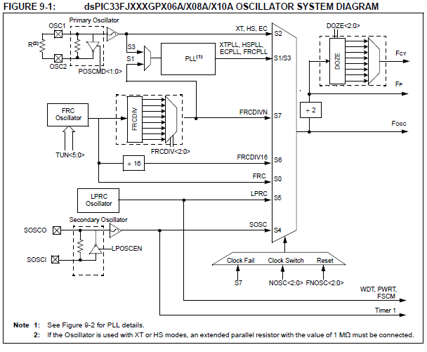
Notes:
Doze mode used to reduce power see section 10.3 of the data sheet. Basically DOZE can slow down your rate of instruction execution while leaving peripherals running at the unreduced speed.
Switching of clock sources for power savings is allowed and can be done dynamically.

Slide 17
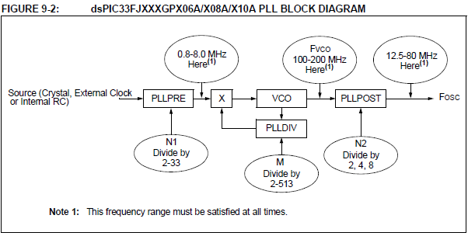
Phased Locked Loop Operation
A PLL is used to increase the source clocks frequency.
The lowest frequency in is 1.6 MHz that can be boosted to 80 MHz

Slide 18
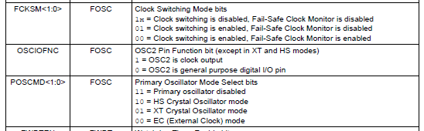
FOSC Main Oscillator
Notes:
FOSC FCKSM 10-clock switching is disabled
FOSC OSCIOFNC 1 - OSC2 is a clock output
FOSC POSCMD 01 - XT Crystal Oscillator mode
We want to disable clock switching, keep OSC2 as a clock output Oscillator. (range is 3-10 MHz the crystal on the explorer 16 board is 8 MHz).
The configuration will be 0xFFBD again for this word

Slide 19
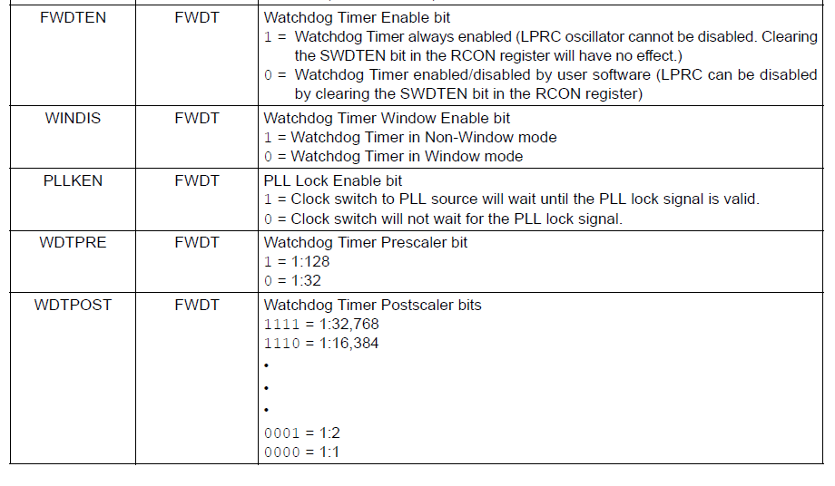
FWDT Watch Dog
Notes:
For debugging purposes we don’t want the watchdog on. For safety reasons it will be on by default. All other bit field are don’t cares once we decide to disable so the configuration word will be 0x7F

Slide 20
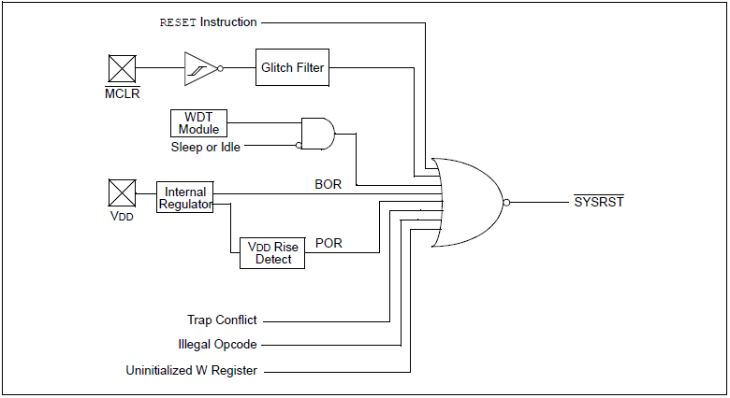
RESET SYSTEM

Slide 21
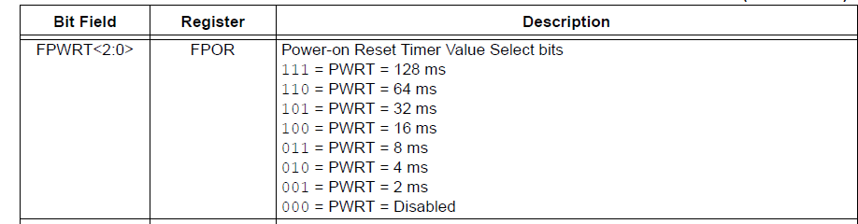
FPWRT Power on Reset Hold
Notes:
This is the time that reset is held on processor right after SYSRST* is released. We will use the longest time 128 ms.

Slide 22
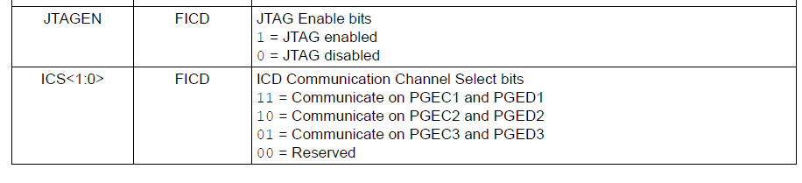
FICD In Circuit Debugging
Notes:
JTAG is a boundary scan ability to verify the ucontroller quickly. For now lets leave it at the default. According to the schematic the PGEC1 and PGED1 are connected to the PICKit 3 connector so we can leave this configuration word as FF

Slide 23
Configuration Method Options
In MPLAB X you must set configuration bits in code
There are two methods of setting configuration bits in code
Macros that are defined in the header for the device
pragma# statements
MPLAB X provides a way of viewing and generating pragma statements. Access it by going to Window->PIC MemoryViews->ConfigurationBits

Slide 24
Using Configuration Macros from p33FJ256GP710A. h Header file
/* Register FOSC (0xf80008) */
extern __attribute__((space(prog))) int _FOSC;
#define _FOSC(x) __attribute__((section("__FOSC.sec"),space(prog))) int _FOSC = (x);
#define FCKSM_CSECME 0xFF3F
#define FCKSM_CSECMD 0xFF7F
#define FCKSM_CSDCMD 0xFFBF
#define OSCIOFNC_ON 0xFFFB
#define OSCIOFNC_OFF 0xFFFF
#define POSCMD_EC 0xFFFC
#define POSCMD_XT 0xFFFD
#define POSCMD_HS 0xFFFE
#define POSCMD_NONE 0xFFFF
Notes:
_FOSC(FCKSM_CSDCMD & POSCMD_XT & OSCIOFNC_OFF);

Slide 25
Using Pragma
// FOSC
#pragma config POSCMD = XT // Primary Oscillator Source (XT Oscillator Mode)
#pragma config OSCIOFNC = OFF // OSC2 Pin Function (OSC2 pin has clock out function)
#pragma config FCKSM = CSDCMD // Clock Switching and Monitor (Both Clock Switching and Fail-Safe Clock Monitor are disabled)
Notes:
It seems like having MPLBX generate nicely commented code is somewhate bteer than putting together the macros.

Slide 26
Single Dimensional Arrays
Declaration is: type var_name[size];
Where type is as detailed above.
Var_name follows the naming convention
Size represents the number in the array.
Example
int i[10]; // declares i as an array of 10X16 integers

Slide 27
for Loops
Example
For (initialization; condition;, increment)
{
code to be repeated
}
Use example
int num;
for (num=1; num<1000; num++)
Notes:
The code will not run if the condition is not initial met.

Slide 28
Incrementing / Decrementing
The third entry into the for loop can be any incrementing or decrementing statement, the increments or decrement can be by any value.
Examples
i =i+1 or i++
i = i -1 or i--
i =i +2
i = i -5

